Slide 1
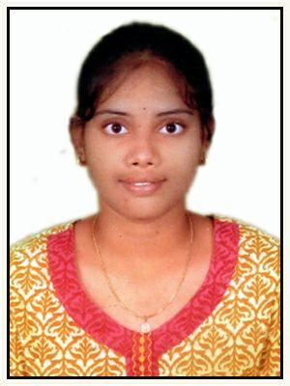
Name P VYSHNAVI
Key Delivery skills and Solutions
Analyst / Software engineer
Tools –Pg admin, Postman
Proficient in Java ,SQL languages
Proficient in HTML
knowledge of core java
Worked on core java
Professional Experience
Understanding requirements, proposing a solution
Efficient in development to meet client business and technical requirements following standards and best practices
Technologies worked on Core java, Postgres SQL, Html, spring boot
Education: Bachelor of Engineering (EEE), JNTUH Hyderabad.
Experience in developing and enhancement of Core Java
Certificates
Certificate of successfully completed training on AWS Cloud Practitioner

